Slide 1
Choosing the right college
Sandy Duong

Slide 2

Context
Help athletes and coaches make better decisions when deciding which college, they should attend/coach at
All data comes from USA Today
Total Pay
Conference
Win %
Want to prove statistically
Whether or not a coach’s salary influences win percentage
Whether the conference a college is from influences win percentage
Notes:
I first off want to say that I am a big fan of college football, its extremely entertaining to see witness the talent from both athlete and schools have, and how they produce top tier NFL athletes. ***CLICK**** I gather you guys today because I want to utilize my analysis to help athletes and coaches make better decisions when deciding which college to attend / work at.
***CLICK****
All my data comes from USA Today, and the ones I am focusing on are:
-the salary each coach was paid for the year of 2019
-the section/conference each college is in, LIST EXAMPLES. (e.g. SEC, PAC-12)
-win / loss ratio of each school, there are 127 schools total
****CLICK*****
Want to prove statistically
-whether or not a coach’s salary influences winning percentage
-whether the conference a college is from influences winning percentage

Slide 3
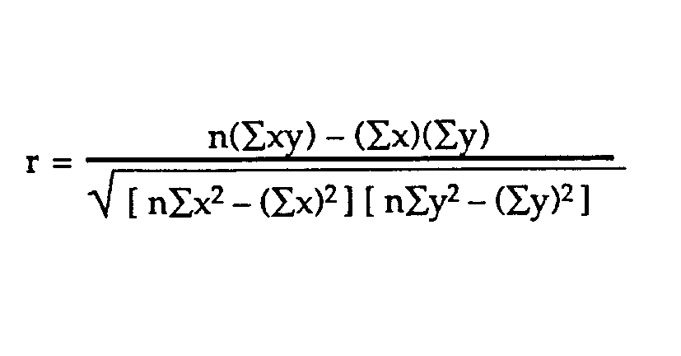
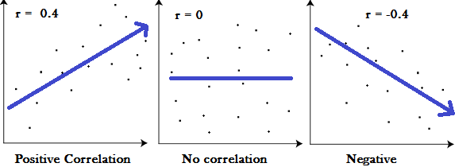
Method
Pearson correlation coefficient
Should be between -1 and 1
Notes:
To test both my hypothesis, I will be using the pearson correlation coefficient ****CLICK*****
to see whether or not there is a direct relationship between a coach’s salary and the win percentage of the school.
****CLICK*****
The pearson correlation coefficient gives me a number between -1 and 1
***CLICK****
A number close to 1 indicates that there is a positive correlation between the two variables, if one variable goes up, so does the other
**CLICK***
A number close to 0 indicates that there is no relationship between the two variables
A number close to -1 indicates that there is a negative correlation between the two variables, if one goes up, the other goes down.

Slide 4
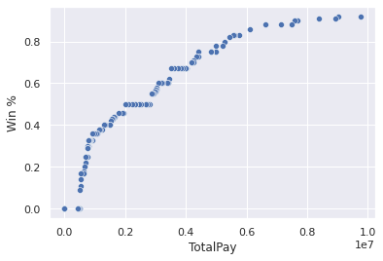
1st Hypothesis
Alternative: The higher the coach’s salary, the better a team’s W/L ratio is
Null: Salaries have no effect on a team’s W/L ratio
Pearson correlation coefficient = 0.926
This number is very close to 1
Notes:
For my first hypothesis, I want to see if a coach’s salary will influence the win percentage of each team ***CLICK**** (read hypothesis)
**CLICK
After running the test for statistical significance, I obtained a coefficient of 0.926
***CLICK
Since this number is extremely close to 1, there is support that these two variables are positively correlated
**CLICK
With that being said, we can reject the null hypothesis in favor for the alternative that the higher the coach’s salary is, the better a team’s W/L ratio is.
**CLICK
For reference as well, I created a scatterplot to better visualize the data and it’s very apparent that there’s a linear relationship going on.

Slide 5
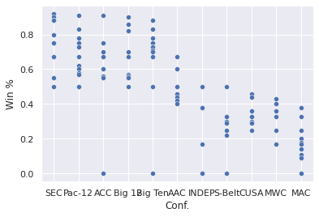
2nd Hypothesis
Alternative: If a team is in the SEC or PAC-12, their win % will tend to be better
Null: Team conference has no effect on the win %
Pearson coefficient: 0.034
Close to 0 = no correlation
Notes:
I wanted to see if the conference a college is in has any effect on their win percentage
***CLICK
I created a scatterplot and it looked very promising that if a school was in the SEC or PAC-12, their win percentage was bound to be better than a school not in the conference
***CLICK
My alternative hypothesis is that if a team is in the SEC or PAC-12, their winning percentage would be greater
The null is that the conference a college is in has no effect on their winning percentage
**CLICK
After running this test to see if these two variables have any correlation, I obtained a coefficient of 0.034, which is close to 0,
***CLICK
we can reject the alternative in favor of the null hypothesis that the conference a college is in has no effect on their winning percentage

Slide 6




Conclusion
A coach’s salary influences the win percentage for the school
The conference a college is in has no effect on winning percentage
Notes:
READ 1st CONCLUSION **CLICK
READ 2nd CONCLUSION **CLICK
I think we can best use this information when athletes or coaches consider choosing a college for them. Athletes want to join a winning team and be part of something great, and coaches want to join a staff that produces teams that win. Its super important for potential candidates/students to know that they are getting into a good school.
I hope that this information I provided you today will help more students/athletes make a better decision when choosing a college

Slide 7


